Slide 1
SECURATHON
Innovate Cybersecurity
PHISHY: AI-Based Phishing Detection Web Extension
Team Name: Aura of Intelligence
N Punith Kumar
Rahul A Gowda

Slide 2
Problem Statement
Phishing Threats: Phishing attacks trick users into sharing sensitive information, leading to financial loss and identity theft.
Vulnerable Groups: Older adults, new employees, and students are at higher risk due to lower digital literacy.
AI Solution: The "PHISHY" project aims to create an AI-based web extension to detect and prevent phishing, enhancing cybersecurity for users.

Slide 3
Why opt for this issue?
Rising phishing threats with evolving tactics targeting vulnerable groups. Traditional methods are no longer sufficient.
Effects: Financial loss, data breaches, and reputation damage for individuals and businesses.
Importance Today: Urgent need to combat growing phishing risks as digital services expand.

Slide 4
Proposed solution
AI-Powered Real-Time Protection: The extension intercepts and scans URLs in real-time to detect phishing attacks.
SOLUTION
Immediate Threat Detection: Real-time scanning prevents access to malicious sites, addressing phishing threats effectively.
Phishing Behavior Analysis: AI analyzes website content for phishing indicators, offering deeper protection beyond URL checks.
File Safety Checks: Users can upload suspicious files for AI-driven malware detection.
Continuous AI Improvement: The AI learns and adapts, improving detection accuracy as phishing techniques evolve.

Slide 5
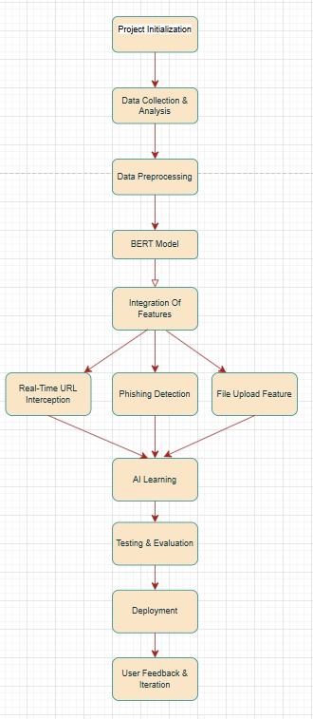
Solution Workflow

Slide 6
Novelty of the solution
Real-Time URL & Content Analysis: PHISHY dynamically scans URLs and evaluates website content using AI, offering deeper analysis compared to traditional blacklist-based systems.
File Upload for Malware Detection: Users can upload suspicious files for AI-powered malware analysis—an uncommon feature in similar solutions.
Comprehensive Threat Detection: Goes beyond just URL filtering by checking both website structures and uploaded files for phishing indicators.
AI-Powered Adaptive Learning: Continuously improves its detection accuracy, learning from new phishing methods to stay ahead of evolving attacks.

Slide 7
Scope of the product
Target Audience:
General internet users (older adults, students)
Company employees (new recruits)
Professionals handling sensitive data
Audience Needs:
User-Friendly Interface: Easy for all users
Comprehensive Protection: Real-time detection for URLs, websites, and files
Long-Term Use:
Continuous AI updates for sustainable protection
Adapts to new phishing techniques over time

Slide 8
Feasibility of the solution
Simple, intuitive interface ensures ease of use for general internet users, employees, and professionals.
Available as a browser extension, it can be quickly installed across major browsers with minimal setup or technical knowledge.
Offers real-time phishing detection and malware analysis.
AI-powered learning continuously improves security, providing long-term reliability and adapting to new threats.

Slide 9
References from Research Papers
Phishing Website Detection May 2024 ,Indian Journal of Data Mining
Phishing Website Detection May 2024 International Journal for Research in Applied Science and Engineering Technology May 2024
Hybrid phishing detection using joint visual and textual identity, Volume 220, 15 June
A Systematic Literature Review on Phishing Website Detection Techniques, Journal of King Saud University - Computer and Information Sciences 35(April) January 2023s

Slide 10
THANK YOU

